Slide 1
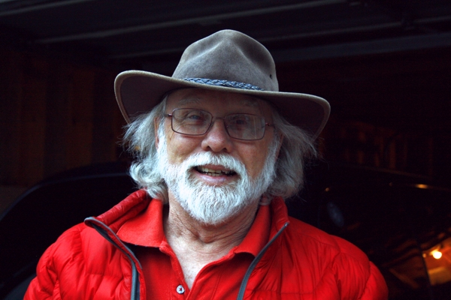
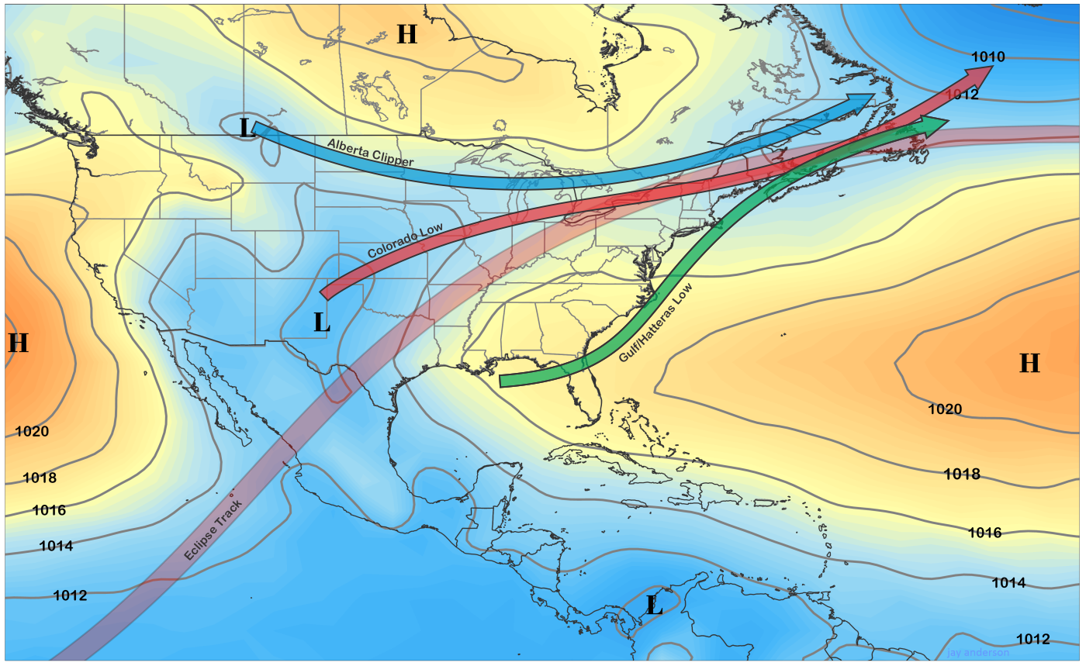
Jay Anderson - I
Photo by Anderson. Favorite eclipses: ’91 Mexico, ’15 Svalbard, ’21 N of Antarctica
© Gerard Williger 2023, U Louisville
Canadian (Winnipeg), meteorologist, amateur astronomer, runs eclipsophile.com
BS UBC, MS Manitoba
Gives information about weather statistics for eclipses for planning
Observed 34 eclipses since 1979
Found ground temperatures drop more than higher up
Avg April sea-level pressure (2000-19) and tracks of most common types of spring storms, with Apr. 8, 2024 eclipse track.

Slide 2
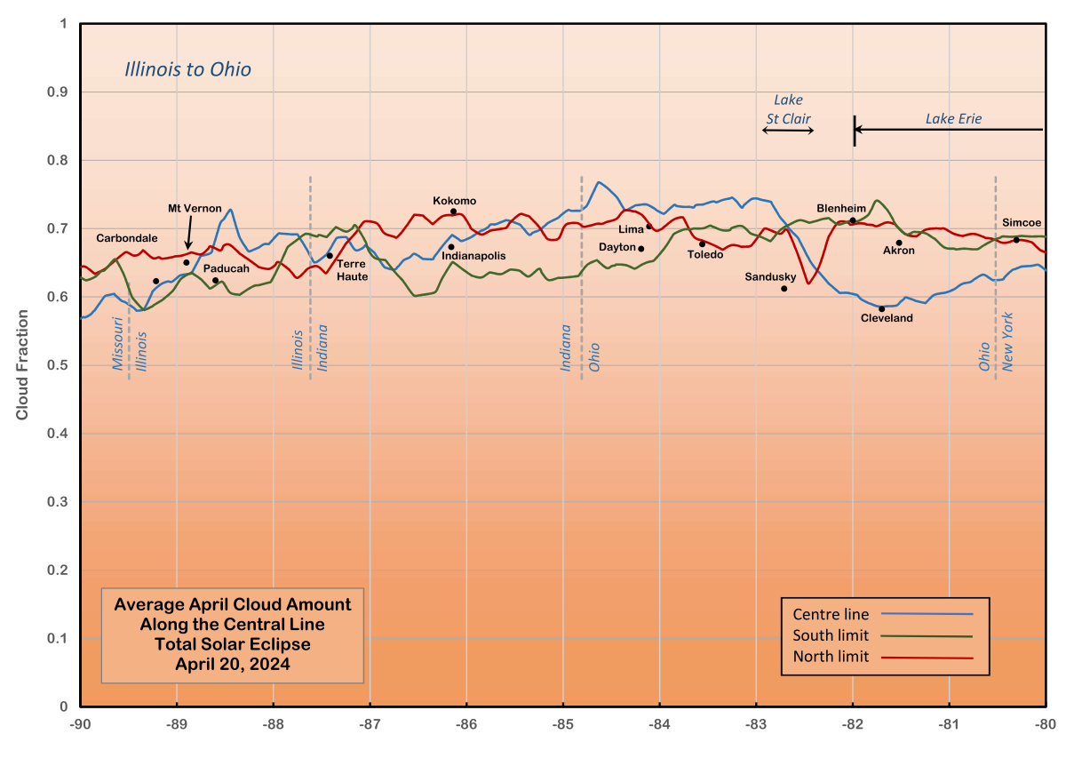
Jay Anderson - II
“Eclipses are a fascinating spectacle that exposes most viewers to a near-religious experience. The shadow of the Moon connects the observer to the Solar System and the spectacle will enliven the soul. The observer is also connected to history and science… for me, eclipses are a way to travel and see the world, meeting ordinary people along the way and helping them to enjoy the eclipse spectacle.”
© Gerard Williger 2023, U Louisville
Mean April afternoon cloud cover alone eclipse centerline, N & S limit from Aqua satellite. Stations plotted by longitude and cloud-cover value.

Slide 3

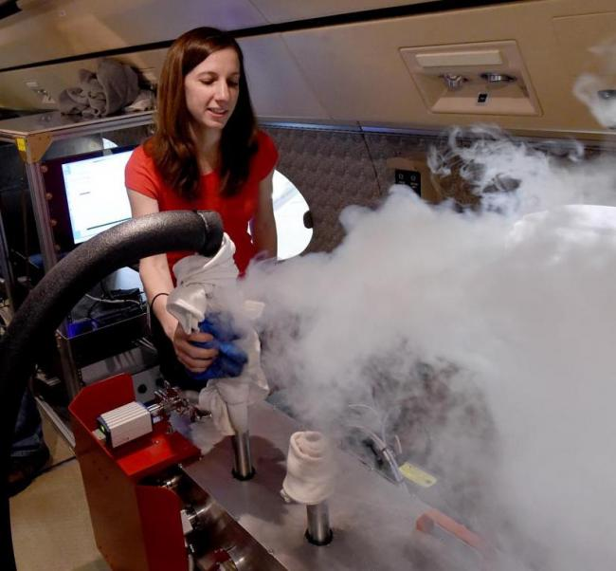
Jenna Samra
© Gerard Williger 2023, U Louisville
Photo from J. Samra,
US, BS ’06, MS ’08 Penn St elec. engineeringworked Lincoln Lab; PhD ’18, Harvard
on airborne IR spectroscopy from the 2017 eclipse
won Int’l Astron. Union PhD Prize (solar division); instrument specialist
Studied eclipses since ’14, for 2017 eclipse over KY; used in 2019 over S Pacific, also
Key finding: temperature, density of corona from IR spectroscopy
Samra and AIR-Spec, June 26, 2019. Harvard site.

Slide 4
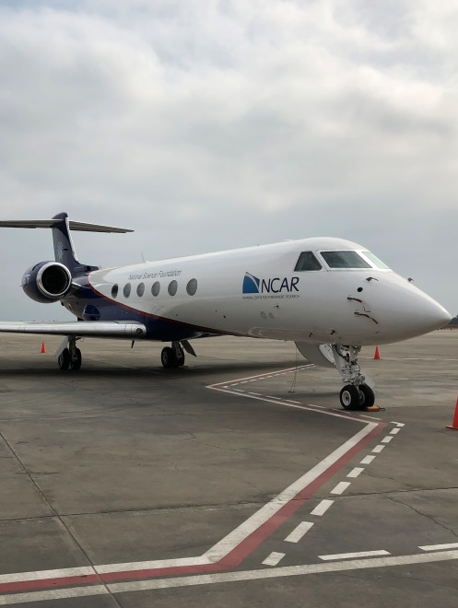
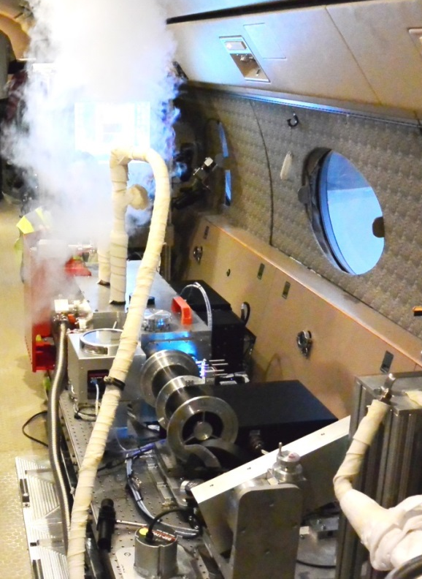
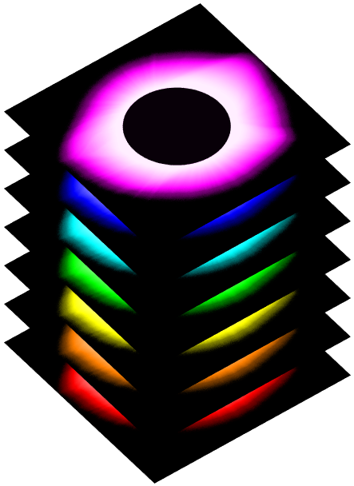

Our First Eclipse Instrument: AIR-Spec
NSF/NCAR Gulfstream V
560 mph
45,000 ft
-190°F
-123°C
Photo from Cory Wolff
Airborne
InfraRed
Spectrometer
Slide from J. Samra

Slide 5
The AIR-Spec Eclipse Observations
Wavelength →
AIR-Spec measures “lines” emitted by the solar corona
We can use lines like these to remotely sense the coronal temperature, density, velocity & magnetic field
← Distance
Emitted by the sun’s corona
Absorbed by earth’s atmosphere
Slide from J. Samra

Slide 6
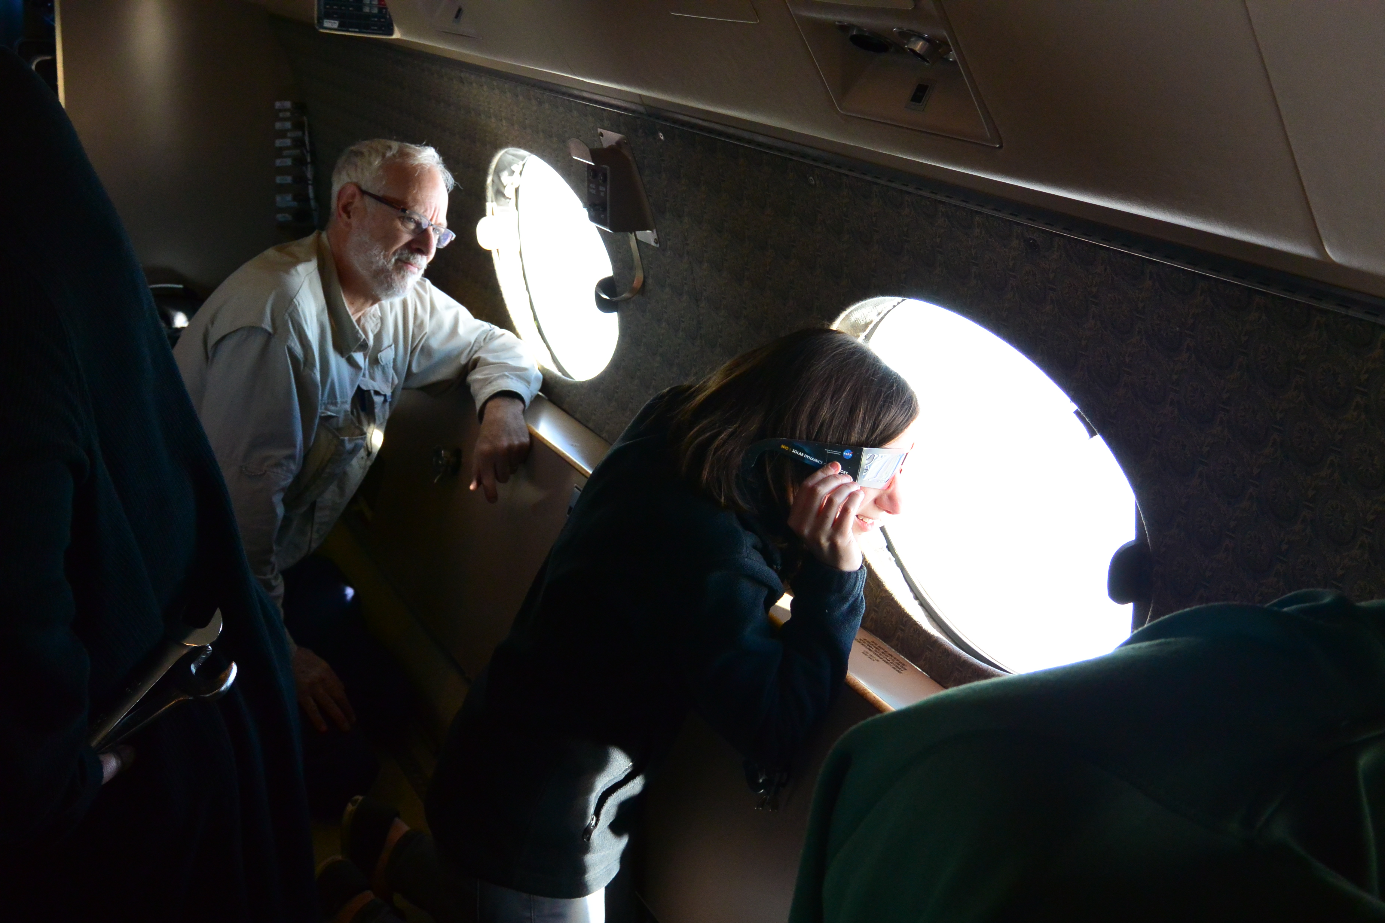
Jenna Samra
© Gerard Williger 2023, U Louisville
“I had to learn about optics to design our instruments and I used a lot of matrix math to determine how to keep the Sun pointed into our telescope as the airplane moved. Perhaps more surprisingly, I had to learn about flight planning in order to design a track that would allow the Gulfstream V pilots to intercept the eclipse at the right time, place, and orientation.” See 13” video in Lec. 6 (science), courtesy Cory Wolff
Photo from Peter Cheimets
Research interests: “… the corona’s magnetic field and building an instrument that can measure it. … [it] is weak and notoriously difficult to observe, but it is incredibly important for understanding the physics of the corona.”
MESSAGE TO STUDENTS: “Try to get yourself into the path of totality in 2024. I have seen the eclipse with my own eyes for only a few seconds, but I can tell you it was spectacular.”

Slide 7
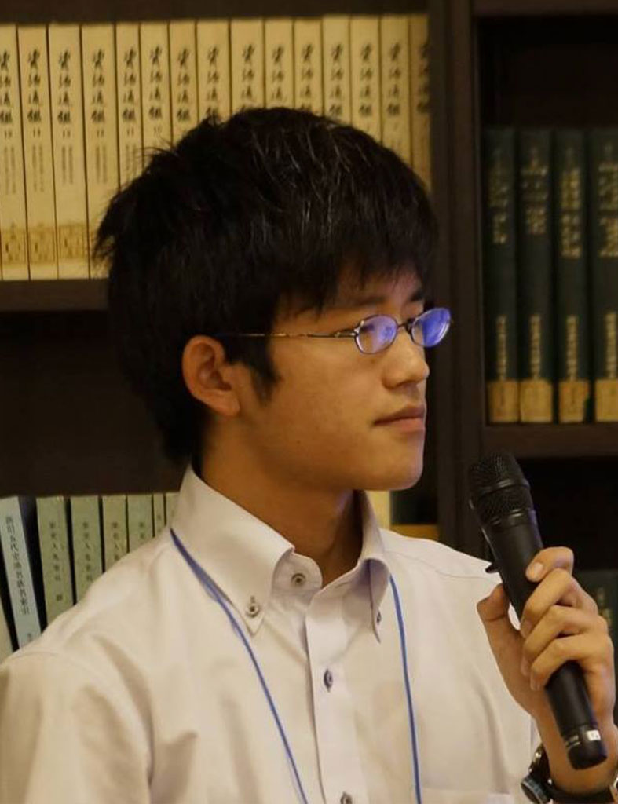
Hisashi Hayakawa - I
© Gerard Williger 2023, U Louisville
Japanese, PhD 2020, Kyoto (science), Osaka (letters); collaborated with Mitsuru Sôma
Asst. Prof, Nagoya U. Main interests: space weather, solar physics, oriental history, history of science
Saw annular eclipse in 2012, piqued interest
Hisashi Hayakawa, Nagoya U.
Hayakawa: “eclipses allow us to understand the variability of solar corona dynamics and Earth’s rotation speed.”

Slide 8
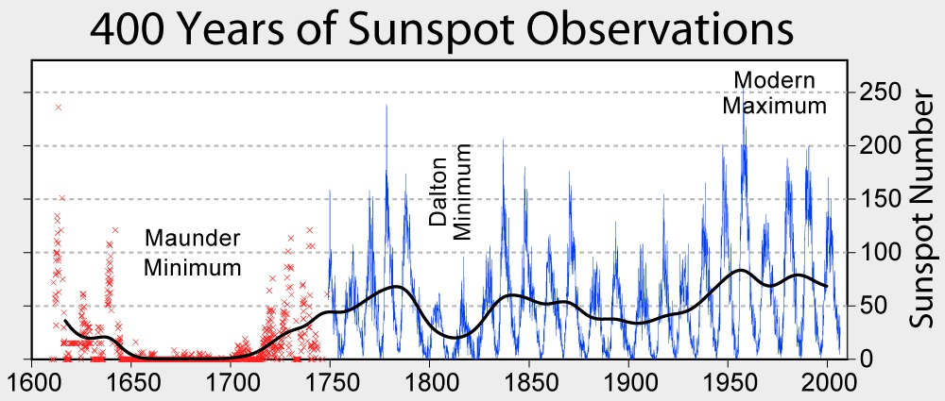
Hisashi Hayakawa - II
© Gerard Williger 2023, U Louisville
Special eclipses:
1706, 1715 – earliest datable drawings of total eclipses
-- Contrast end, aftermath of “Maunder Minimum”
---- when sunspots and solar output were very low
1706 – no streamers
1715 – significant streamers
1806 – earliest drawing from US
-- in middle of “Dalton Minimum”
---- but had significant coronal streamers
------ thus different from Maunder Minimum
Techniques: “archival investigations … and contextualized eclipse records with the … sunspot number, … solar flux etc.”
Little Ice Age
Cooling
Source: Wikipedia
Notes:
1706 eclipse was in Spain, France, Germany; 1715 was in England

Slide 9
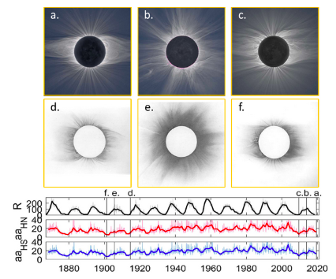
Hisashi Hayakawa - III
© Gerard Williger 2023, U Louisville
From Hayakawa et al. (2021, J Space Weather, 11).
Figs. a, b, c from end, max, start of Cy 24, processed by M Druckmüller.
Figs. d, e, f from end, max and start of Cy 14, from photographic plates. See article for details.
2019
2013
2009
1914
1905
1901
Solar Activity

Slide 10
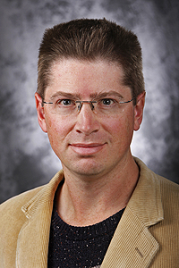

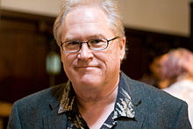
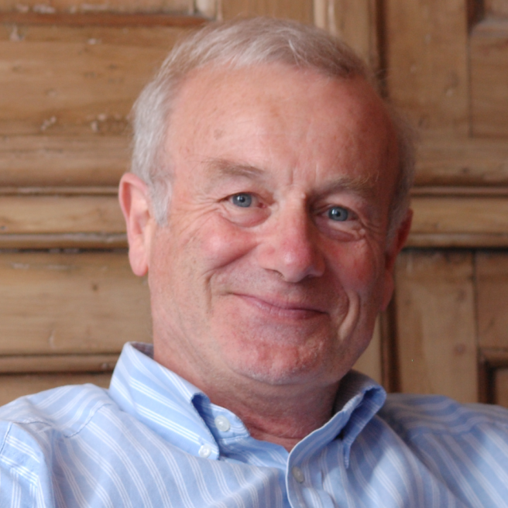
A Sample of Authors
© Gerard Williger 2023, U Louisville
Tyler Nordgren (b. 1969) – Wikipedia
PhD Astronomy, Cornell; Prof. U. Redlands (CA)
Sun, Earth, Moon (Hachette, 2016), also Space Art Travel Bureau (website), space.com interview 2017
David Baron, science writer – Wikipedia
American Eclipse: A Nation’s Epic Race to Catch the Shadow of the Moon and Win the Glory of the World (Liveright, 2017)
John Dvorak (b. 1952); website
PhD Geoscience; Mask of the Sun: The Science, History and Forgottten Lore of Eclipses (Pegasus, 2017)
Francis Edwin Close, OBE (b. 1945)
PhD Physics, Oxford (current Prof. emeritus) ; Wikipedia
Eclipse: Journeys to the Dark Side of the Moon (Oxford U. Press, 2017) + other popular science works
Tyler Nordgren, 2010 – image esri.com
David Baron, 2017 – Image St. Louis Public Radio
Video greeting to class! (2’)
John Dvorak, 2007, Wikimedia commons
Francis E. Close, undated, Oxford U. Physics

Slide 11
SUMMARY
© Gerard Williger 2023, U Louisville
Ancient times – 16th cent:
Eclipse observers, recorders, predictors, improvers
Includes Babylonians, Chinese, Greeks, Arabs, Europeans
Helped navigation
17th-18th cent:
Models now good enough to predict eclipse paths
Kepler, Newton, Halley; still for navigation, also science
18th-19th cent: Voyages to see eclipses, especially with railroads, steamships – science
Cook, Baily, Janssen, Lockyer, Mitchell, Todds
Improvers: Hill & Brown
20th-21st cent:
Science, photography, psychology, meteorology, tourism, education, historical eclipses, authors – list is long!

